Slide 1
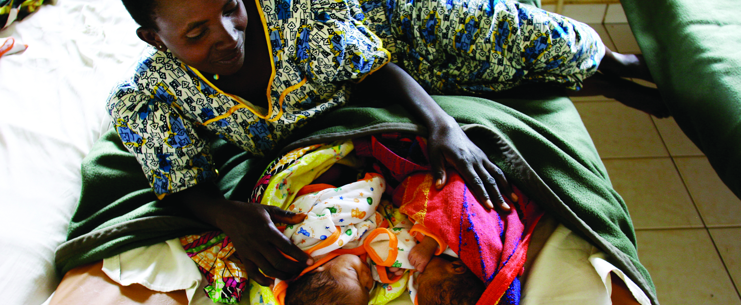

Ubuzima bw’imyororokere
KINYARWANDA
AMAHUGURWA Y'ABAJYANAMA B'UBUZIMA

Slide 2
Uko Umugore Asama

Slide 3
Kubura Imihango
Ibimenyetso byo gutwita
Kuryaryata kw’amabere

Slide 4
Kuruka no Kugira Iseseme
Ibimenyetso byo Gutwita
Inda Irakura Ikaba Nini

Slide 5
Umwana Akurira muri Nyababyeyi

Slide 6
Umugore atwita Amezi 9

Slide 7
Ibise (ububabare bwo kujya ku nda)
Kujya ku Nda (ibise)
Kumeneka kw’isuha

Slide 8
Kubyara
Kubyara
Kubyara iya nyuma (ingobyi)

Slide 9
Kurya indyo ifite intungamubiri zihagije
Umugore agomba Kugira ubuzima buzira umuze igihe atwite
Gukoresha umunyu urimo Iyodi
Gufata inyongera ya Feri

Slide 10
Kuryama mu Nzitiramibu
Umugore agomba kugira Ubuzima buzira umuze igihe Atwite
Kuryama no Kuruhuka Bihagije

Slide 11
Kugira Isuku ku Mubiri no Koza Amenyo
Umugore agomba kugira ubuzima buzira umuze igihe atwite
Kwisuzumisha inshuro zose zitegetswe mbere yo kubyara

Slide 12
Kwirinda kunywa Ibisindisha cyangwa Itabi
Umugore agomba kugira ubuzima buzira umuze igihe atwite
Kwirinda Imiti Atandikiwe na Muganga

Slide 13
Kwirinda gusabana cyane n’abantu barwaye
Umugore agomba kugira ubuzima buzira umuze igihe atwite
Kudahohoterwa

Slide 14
1. Umuganga asuzuma umuvuduko w’amaraso, uko umutima utera ndetse n’umwijima by’umugore.
Kwisuzumisha mbere yo kubyara
2. Asuzuma umwana uri mu nda (uko umutima utera, imikurire, n’uburyo umwana yicaye mu nda).

Slide 15
3. Amuha urukingo rw’akaniga (tetanus) n’izindi nkingo niba ari ngombwa.
Kwisuzumisha mbere yo kubyara
4. Amuha ikinini cya Feri cyangwa Vitamini A iyo abikeneye.

Slide 16
5. Asuzuma niba umugore afite amaraso ahagije mu mubiri agenzura niba inzara z’intoki ziteruruka.
Kwisuzumisha mbere yo kubyara
6. Amubaza ibijyanye no kwirinda malariya ndetse n’uko akoresha inzitiramibu.

Slide 17
7. Amubaza ibyerekeranye no kwipisha SIDA, uko ahagaze, ibyerekeranye n’indwara zandurira mu mibonano mpuzabitsina ndetse n’ibyo kwipimisha no kugirwa inama ku bushake.
Kwisuzumisha mbere yo kubyara
8. Yuzuza ifishi y’umubyeyi (yo kwisuzumishirizaho mbere yo kubyara) hanyuma akamubwira igihe azagarukira.

Slide 18
Uko abana bashobora kwandura agakoko gatera SIDA
Babatwite
Igihe bari ku nda no mu Kubyara
Iyo ba nyina babonkeje batarafashe imiti igabanya ubukana bw’agakoko gatera SIDA

Slide 19
Kurinda umubyeyi ubana n’ubwandu bwa SIDA kwanduza umwana (PMTCT mu rurimi rw’icyongereza)

Slide 20
Kurinda umubyeyi kwanduza umwana igihe amutwite
Kwipimisha ubwandu bw’agakoko gatera SIDA
Kwisuzumisha mbere yo kubyara
Gufata imiti 3 igabanya ubukana bw’agakoko gatera SIDA
Ingaruka mbi ziterwa n’imiti igabanya ubukana bw’agakoko gatera SIDA

Slide 21
Umunaniro Ukabije

Slide 22
Umuriro

Slide 23
Kubyimba mu maso n’ibiganza

Slide 24
Kuva cyane

Slide 25
Kuribwa cyane mu nda

Slide 26
Abagore bakunze guhura n’ingorane mu gihe cyo gutwita ndetse no Mu kubyara

Slide 27
Isura ry’Umujyanama w’Ubuzima

Slide 28
Konsa
Isura ry’Umujyanama w’Ubuzima
Amata y’ifu ku bana bamwe

Slide 29
Kuryama mu nzitiramibu
Ubuzima bw’Umubyeyi n’Umwana Ukivuka
Kuruhuka

Slide 30
Gufungura no Kunywa neza
Ubuzima bw’Umubyeyi n’ubw’Umwana Ukivuka
Kwirinda gukora imibonano mpuzabitsina kugeza ku byumweru 6

Slide 31
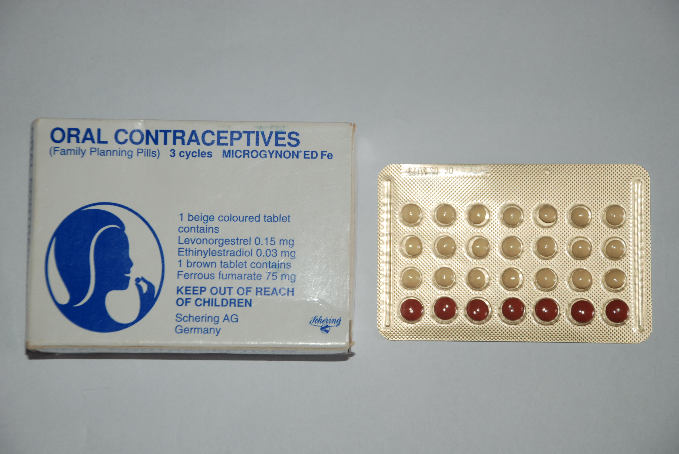
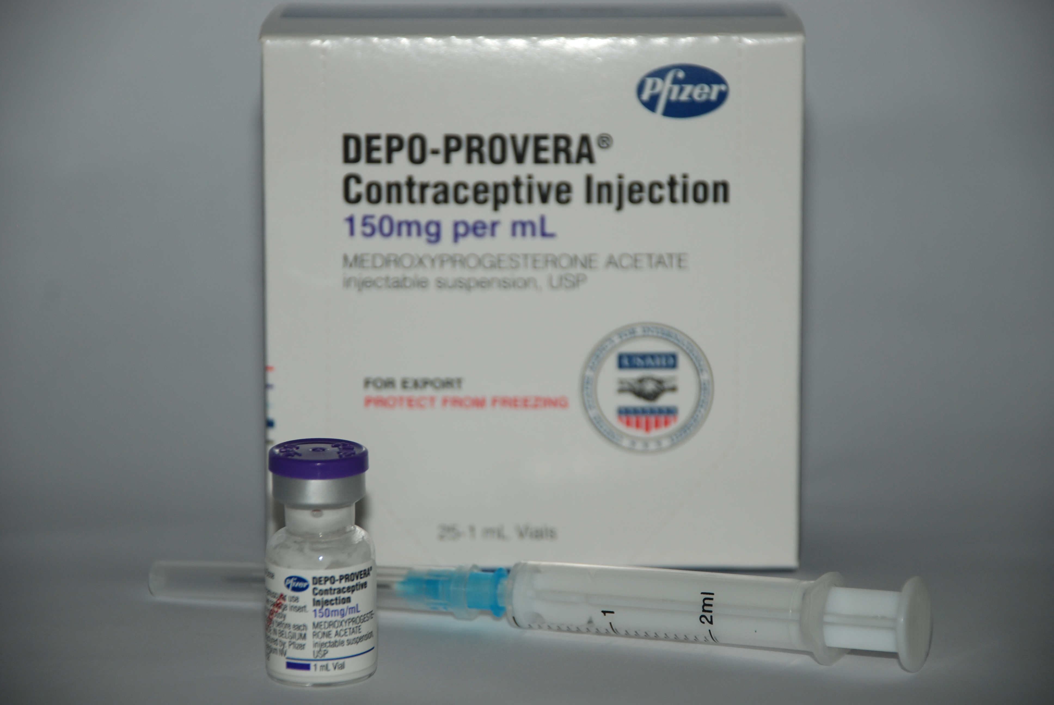
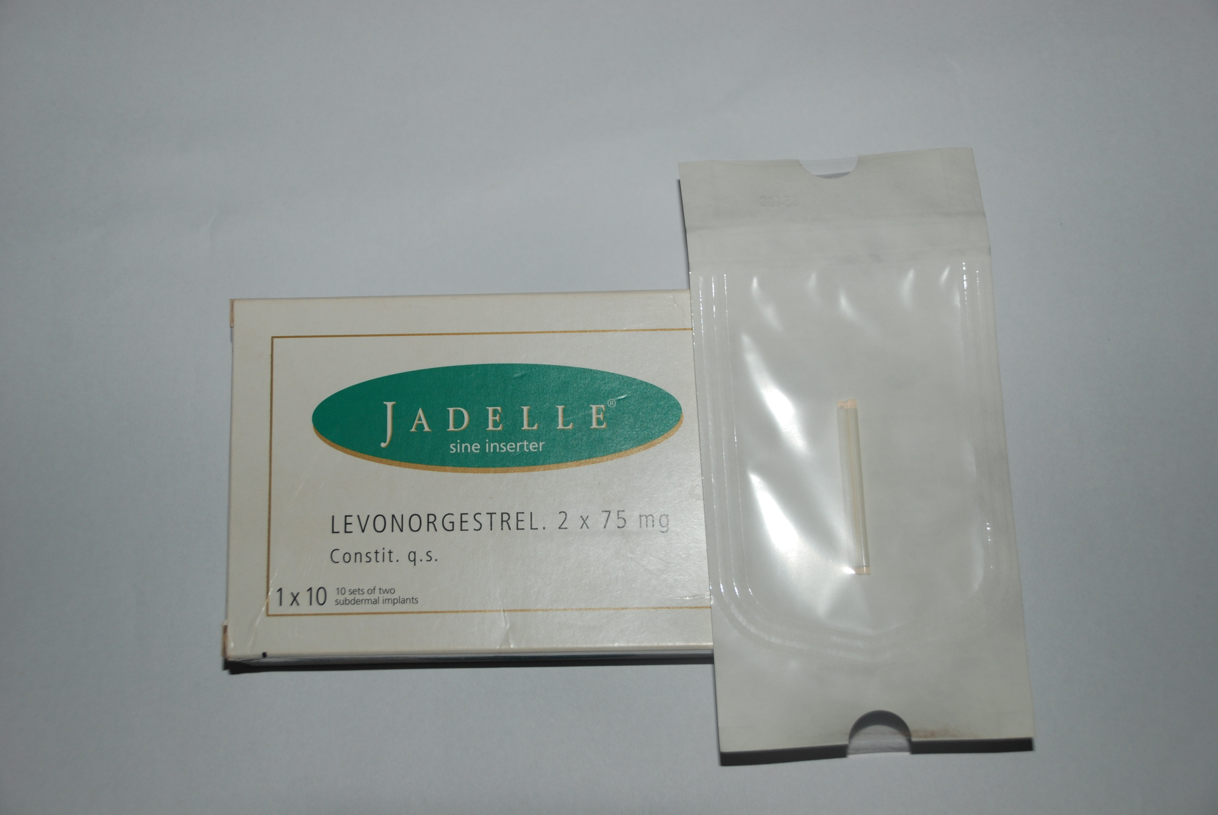
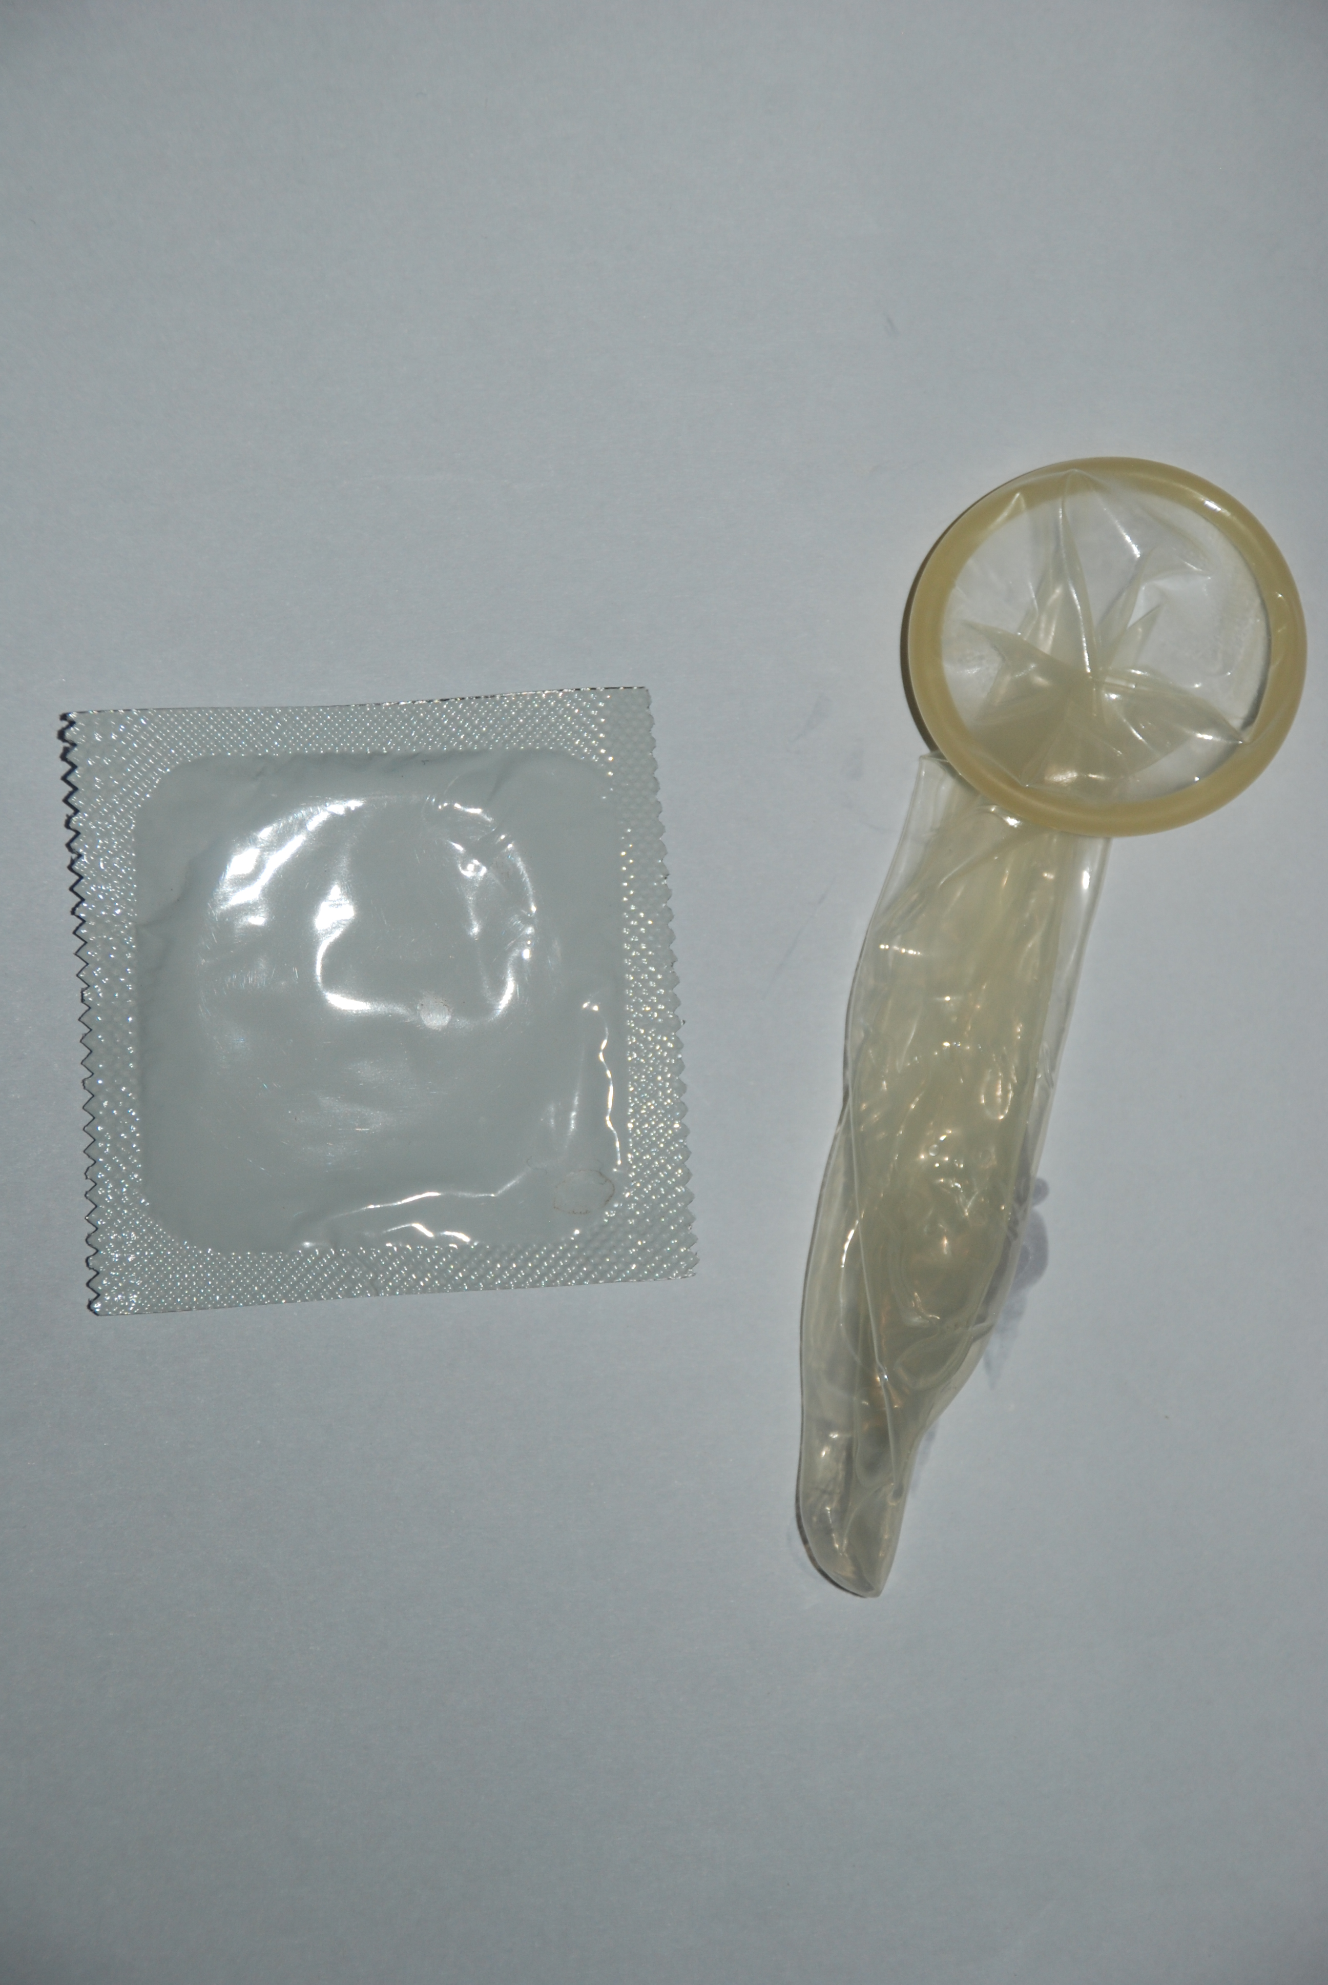
Kuboneza urubyaro
Ubuzima bw’Umubyeyi n’Umwana Ukivuka
Umubyeyi ntagomba kuva cyane

Slide 32
Umwana agomba guhora ashyushye
Ubuzima bw’Umubyeyi n’ubw’Umwana Ukivuka
Umubyeyi ntagomba kuva cyane

Slide 33
Ubuzima bw’Umubyeyi n’bw’Umwana Ukivuka

Slide 34
Konsa

Slide 35
Kurinda umubyeyi ubana n’ubwandu bwa SIDA kwanduza umwana we mu gihe cy’Ibise no mu Kubyara
Kumeneka kw’isuha
Ibise
Kubyarira kwa muganga

Slide 36
Kurinda Umubyeyi Ubana n’Ubwandu Bwa Sida Kwanduza Umwana We Igihe Amubyara Na Nyuma yaho
Imiti igabanya ubukana n’umuti wa Nevirapine
Kujya kwisuzumisha nyuma yo kubyara no kwipimisha ubwandu bw’agakoko gatera SIDA
Inkingo

Slide 37
Kurinda Umubyeyi Ubana n’ Ubwandu bwa SIDA Kwanduza Umwana we no Konsa

Slide 38
Amata y’ifu (insimburabere)

Slide 39
Tubashimiye kuba mwitabiriye aya mahugurwa!

